Slide 1
Graphic Models
Donghai Guan
Nanjing University of Aeronautics and Astronautics (NUAA)

Slide 2

Graphic Models – Why Care?
Play Tennis Example

Slide 3
Graphic Models – Why Care?
Bayes
P(P=yes, O=sunny, T=hot, H=normal, W=strong)
P(P=yes) × (easy)
P(O=sunny|P=yes) × (easy)
P(T=hot|O=sunny,P=yes) × (not easy)
P(H=normal | T=hot,O=sunny,P=yes) × (need more training data )
P(W=strong | H=normal, T=hot, O=sunny, P=yes)

Slide 4
Graphic Models – Why Care?
Naive Bayes
P(P=yes, O=sunny, T=hot, H=normal, W=strong)
P(P=yes) × (easy)
P(O=sunny|P=yes) × (easy)
P(T=hot|P=yes) × (easy)
P(H=normal | P=yes) × (easy)
P(W=strong | P=yes) (easy)

Slide 5
Graphic Models – Why Care?
Bayes is too difficult
Naive Bayes is too simple
  Its assumption is too strict
Bayes
Bayes Network
Naive Bayes

Slide 6
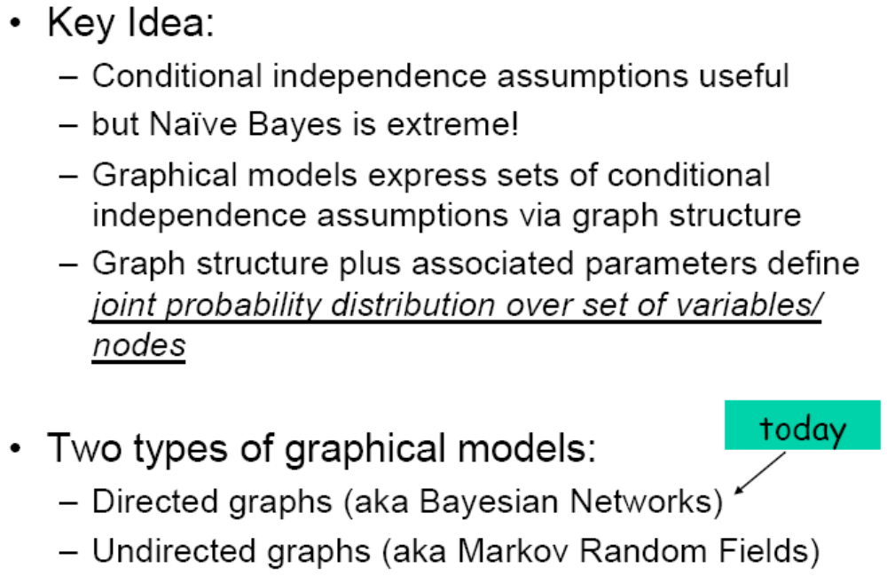
Graphical Models

Slide 7
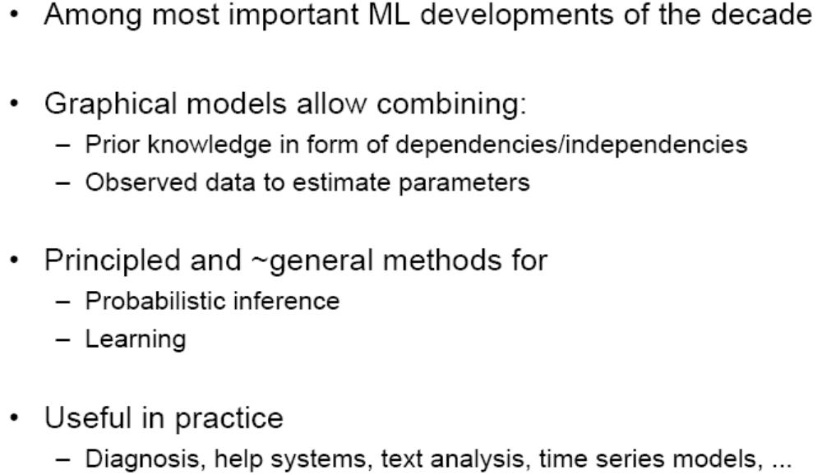
Graphical Models – Why Care?

Slide 8
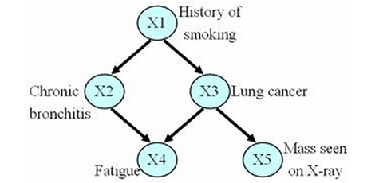
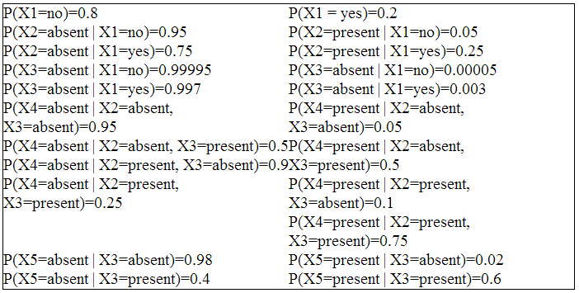
Represent Joint Probability Distribution Over Variables

Slide 9
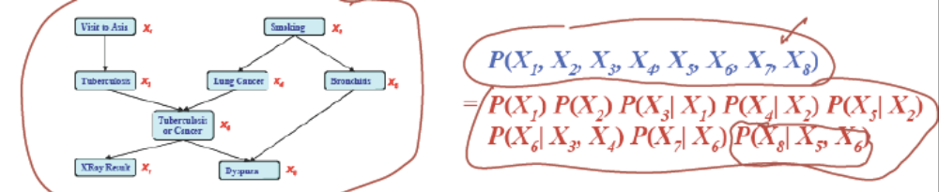
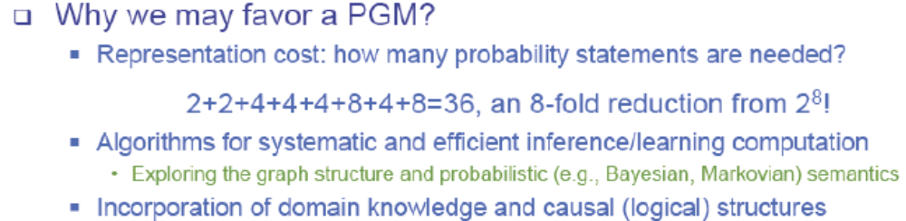
Bayesian Network define Joint Distribution in terms of this graph, plus parameters
If X_{i}’s are conditionally independent, the joint can be factorized to a product of simpler terms

Slide 10
Bayesian Network
Bayes network: a directed acyclic graph defining a joint probability distribution over a set of variables
Each node denotes a random variable
A conditional probability distribution (CPD) is associated with each node N, defining P(N|Parents(N))
The joint distribution over all variables in the network is defined in terms of these CPD’s, plus the graph

Slide 11
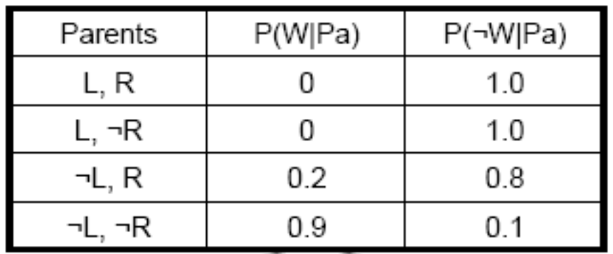
Bayesian Network
StormClouds
StormClouds
StormClouds
Lightning
Lightning
Lightning
Rain
Rain
Rain
WindSurf
WindSurf
Thunder
WindSurf
Thunder
Thunder

Slide 12
Bayesian Network
Each node is
conditionally
independent of its
non-descendents,
given only its
immediate parents.
StormClouds
Lightning
Rain
Thunder
WindSurf

Slide 13

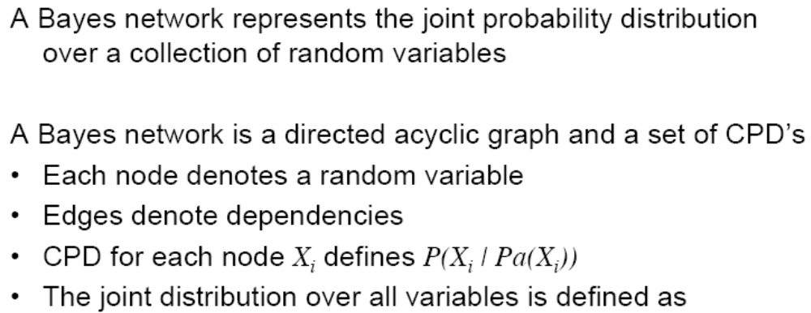
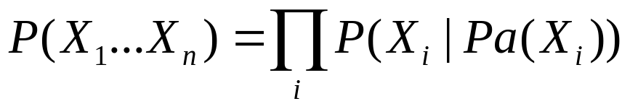
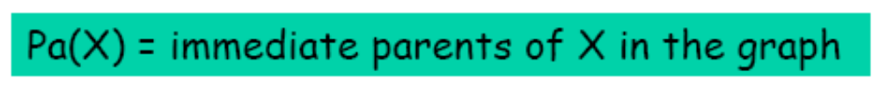
Bayesian Network Definition

Slide 14
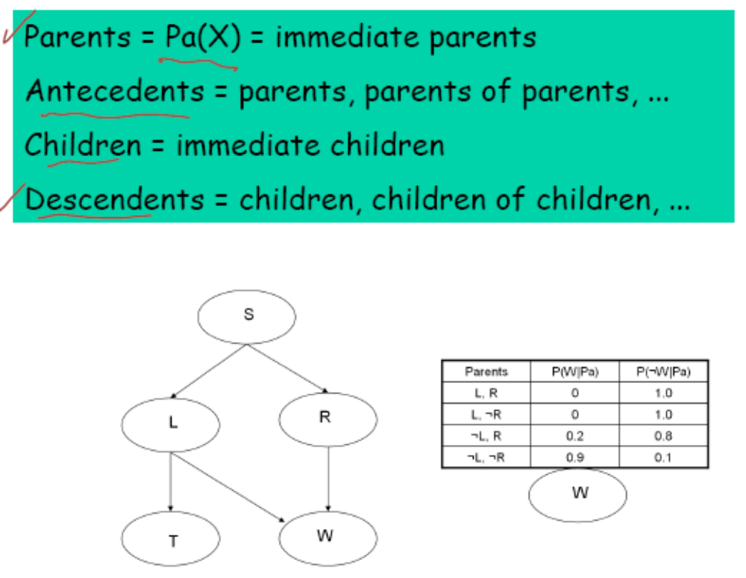
Some helpful terminology

Slide 15
Bayesian Networks
CPD for each node X_{i} describes P(X_{i}|Pa(X_{i}))
Chain rule of probability
But in a Bayes net:

Slide 16
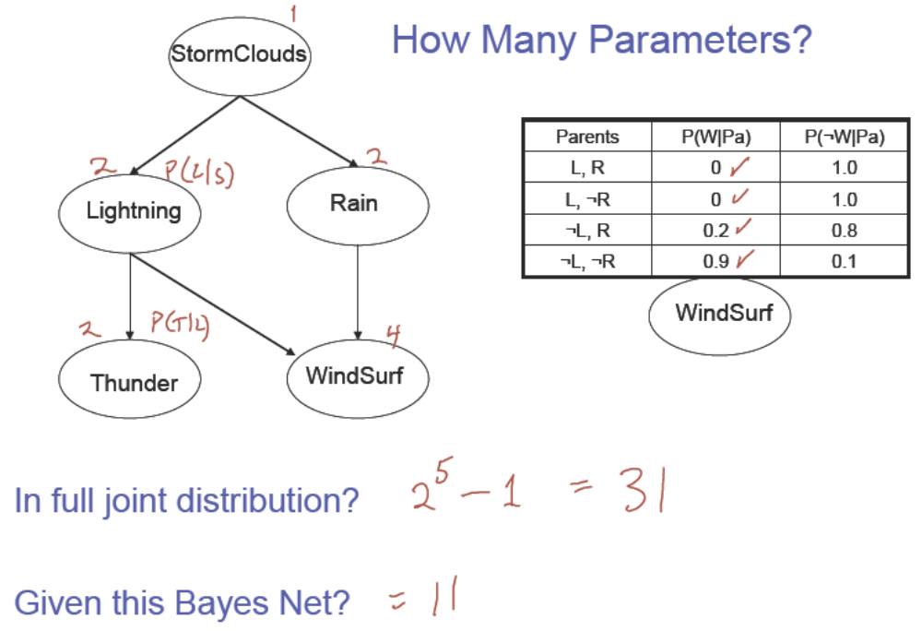
How Many Parameters?

Slide 17
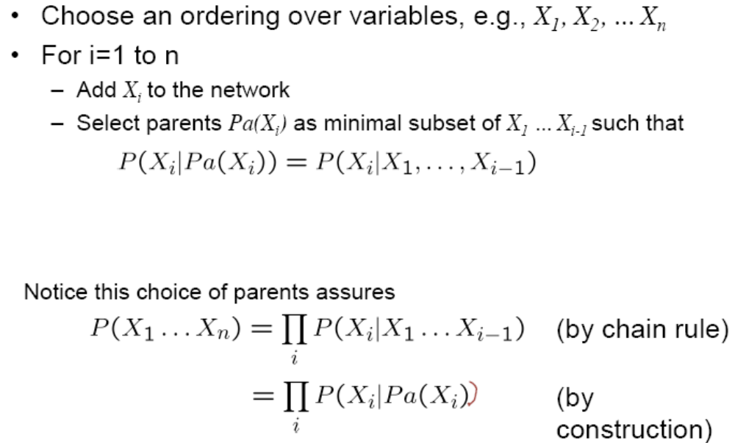
Algorithm for Constructing Bayes Network

Slide 18
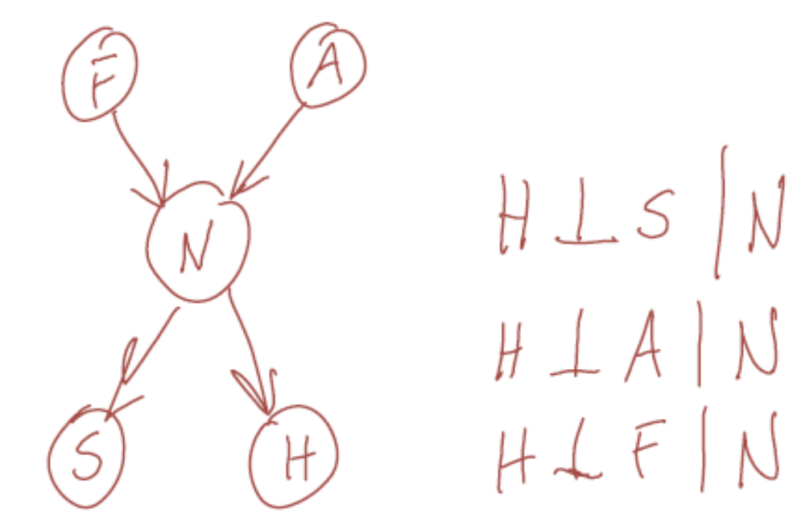
Example
Bird Flu and Allegies both cause Nasal problems
Nasal problems causes Sneezes and Headaches

Slide 19
What is the Bayes Network for X₁…X_{n} with NO assumed conditional independencies?
X4
?
X1
X2
X3

Slide 20
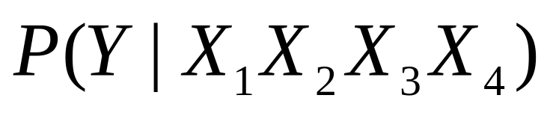
What is the Bayes Network for Naive Bayes
Y
?
X1
X2
X3
X4

Slide 21
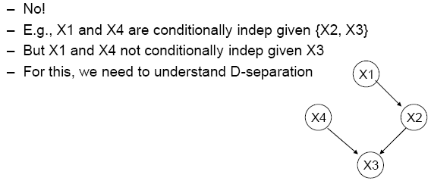
Conditional Independence, Revisited
We said: Each node is conditionally independent of its non-descendents, given its immediate parents
Does this rule give us all of the conditional independence relations implied by the Bayes Network? -- NO!!

Slide 22
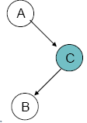
Easy Network1: Head to Tail
Prove A cond indep B given C?
i.e., p(a,b|c)=p(a|c) p(b|c)
Why?
Try to prove it?

Slide 23
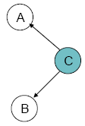
Easy Network2: Tail to Tail
Prove A cond indep B given C?
i.e., p(a,b|c)=p(a|c) p(b|c)
Why?
Try to prove it?

Slide 24
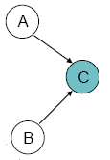
Easy Network3: Head to Head
Prove A cond indep B given C?
i.e., p(a,b|c)=p(a|c) p(b|c)
Why?
Can you prove it?

Slide 25
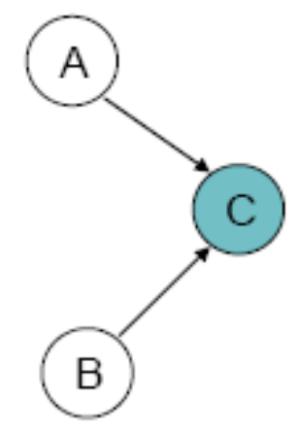
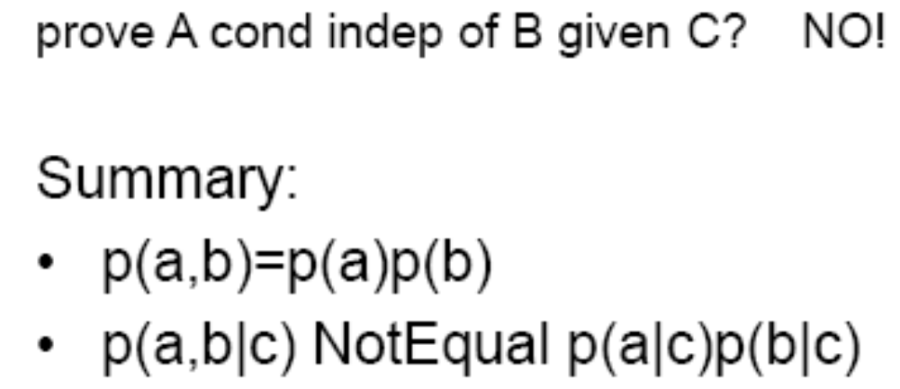
Easy Network3: Head to Head

Slide 26
D-Separation
X and Y are conditionally independent given Z, if and only if X and Y are D-separated by Z.
X and Y are D-separated by Z iff every path from any variable in X to any variable in Y is blocked

Slide 27
D-Separation
A path from variable A to B is blocked if it includes a node such that either
Arrows on the path meet either head-to-tail or tail-to-tail at the node and this node is in Z
Arrows meet head-to-head at the node, and neither the node, nor any of its descendents, is in Z

Slide 28
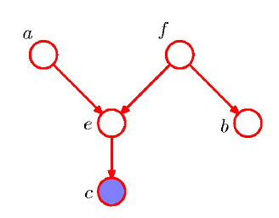
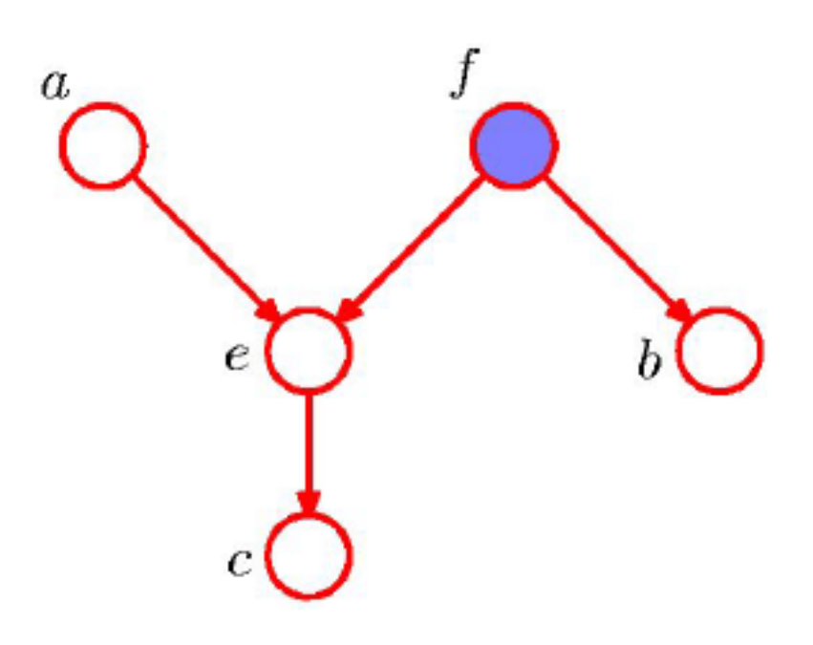
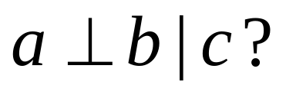
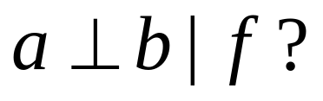
D-Separation: Example

Slide 29
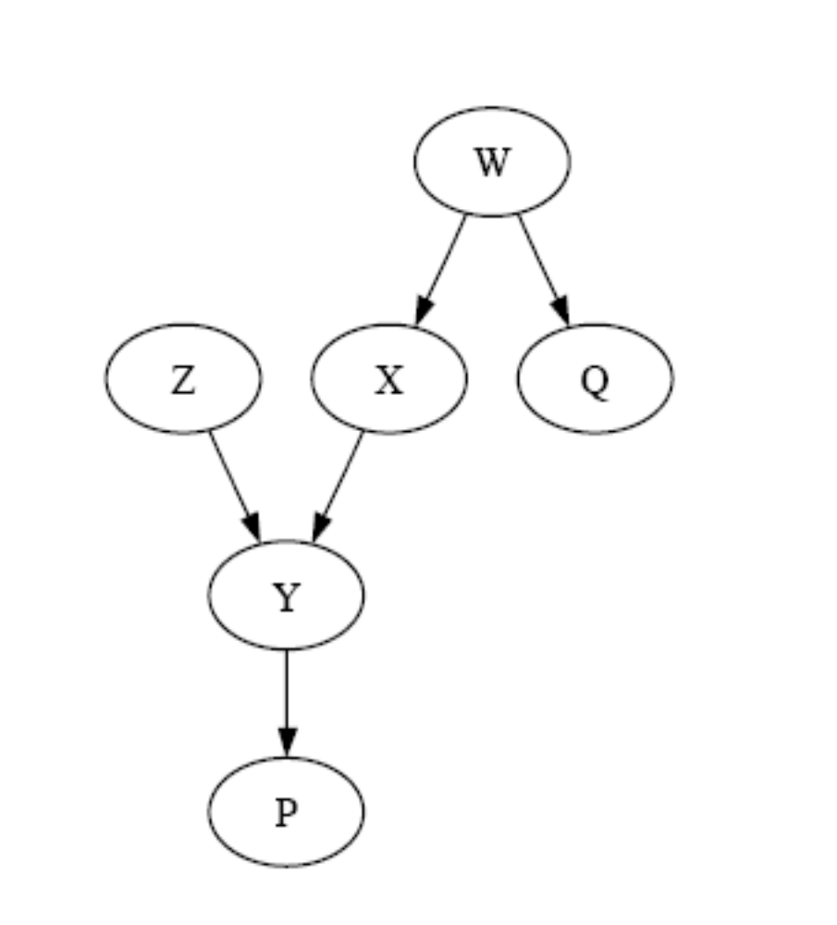
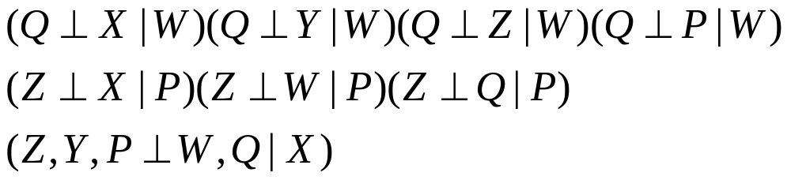
D-Seperation: Example
Notes:
Yes, no ,Yes

Slide 30
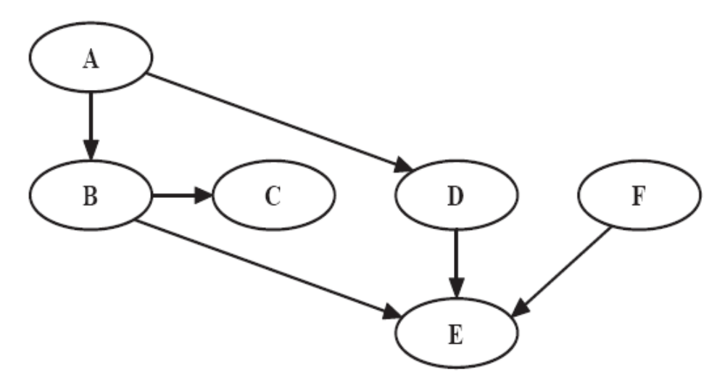
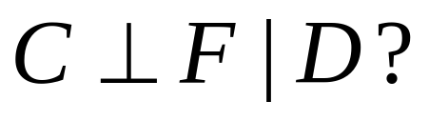
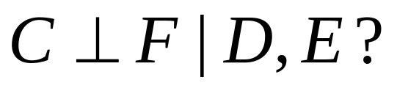
D-Seperation: Example
Notes:
Yes, No

Slide 31
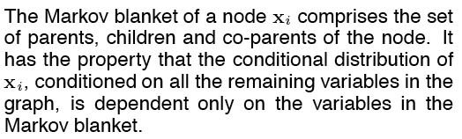
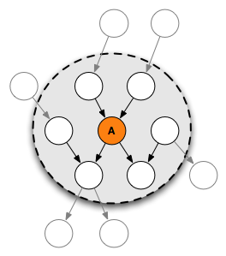
Markov Blanket

Slide 32
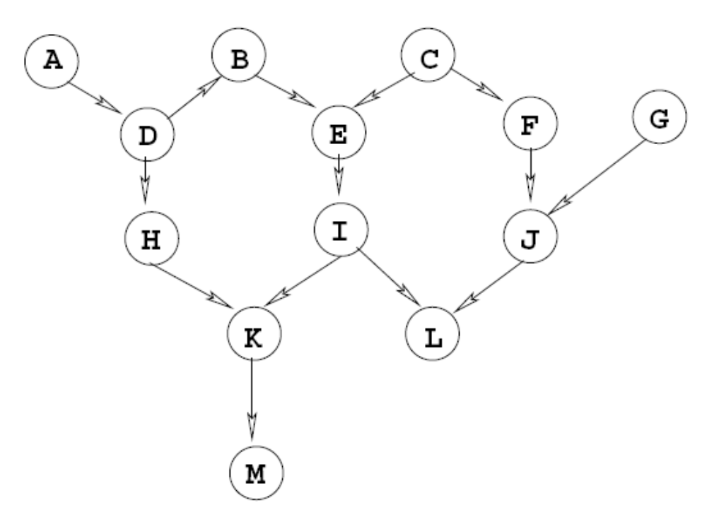
Markov Blanket
Notes:
The Markov Blanket of I is {E,H,J,K,L}

Slide 33
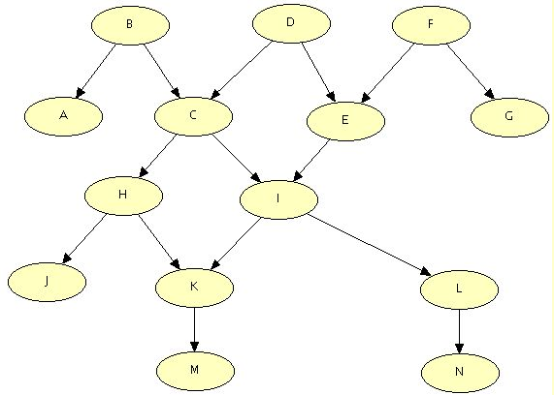
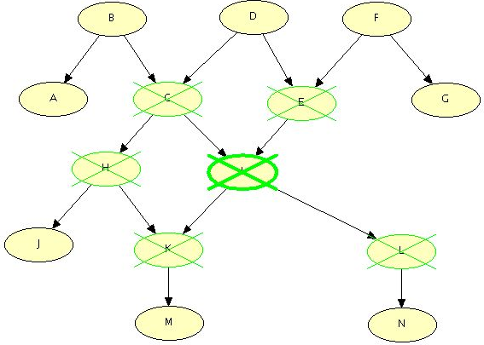

Slide 34
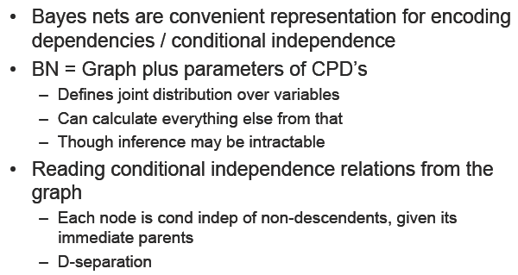
What You Should Know

Slide 35
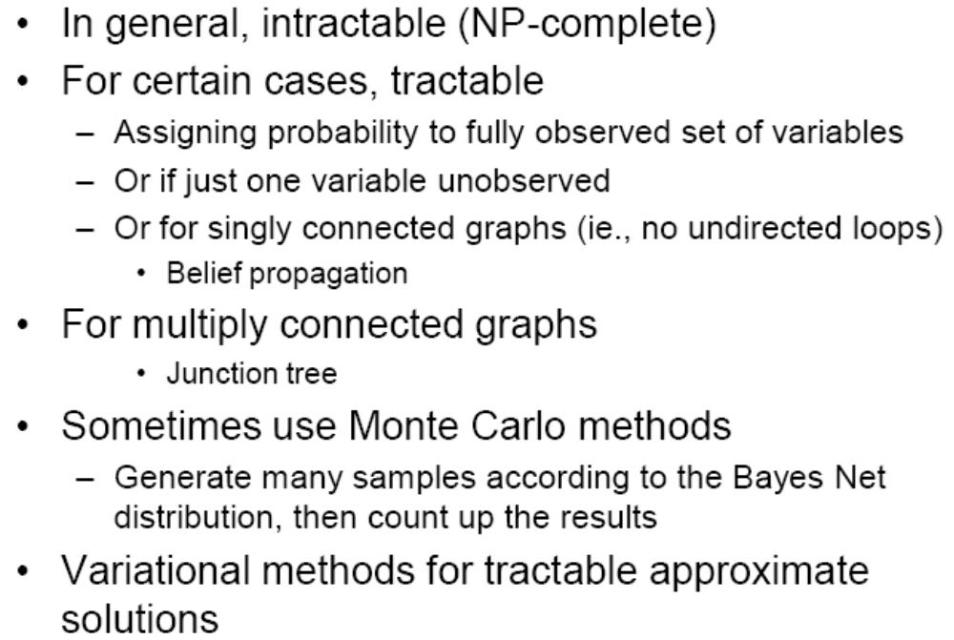
Inference in Bayes Nets

Slide 36
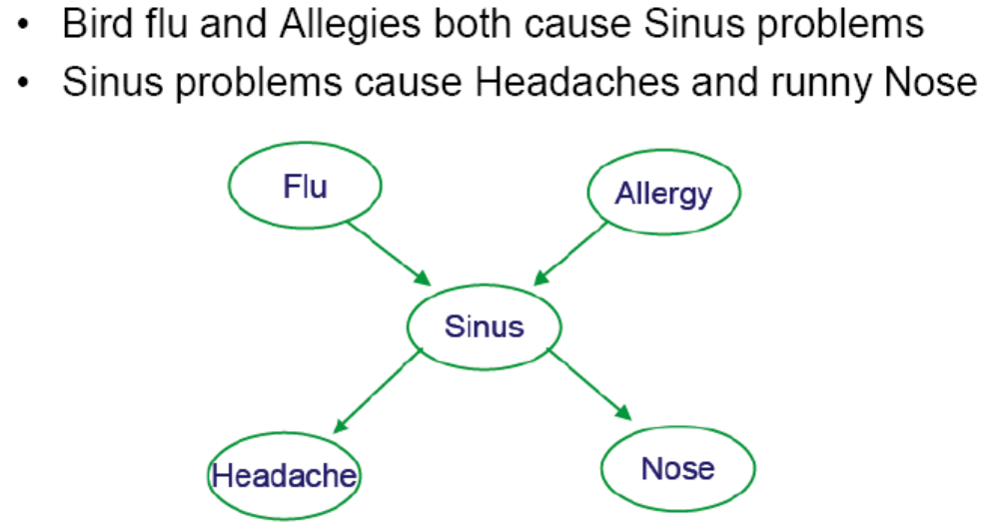
Example

Slide 37
Prob. of joint assignment: easy
Suppose we are interested in joint assignment <F=f, A=a, S=s, H=h, N=n>
What is P(f,a,s,h,n)?

Slide 38
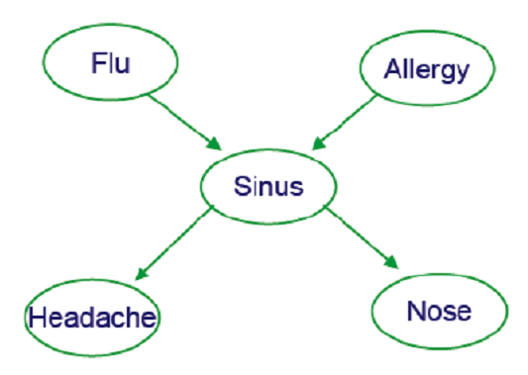
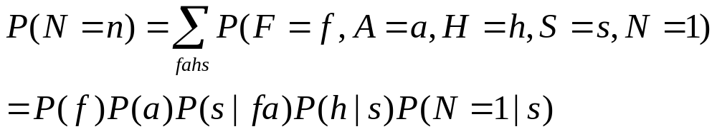
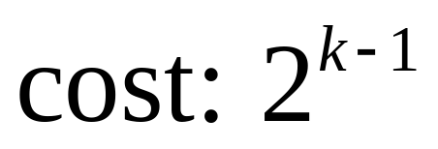
Prob. of marginals: not so easy
How do we calculate P(N=n)?

Slide 39
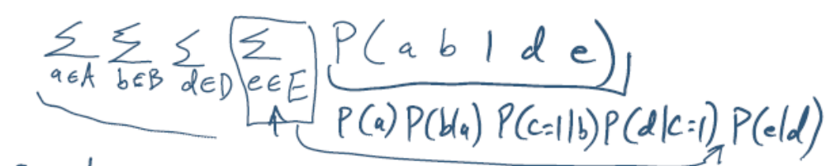
Probability of marginals: not so easy
Sometimes the structure of the network allows us to be clever – avoid exponential work
Boolean Viarable. What is P(C=1)

Slide 40

Generating a sample from joint distribution: easy!
How can we generate random samples drawn according to P(F,A,S,H,N)?
Randomly draw a value for F=f
Draw r∈[0,1] uniformly
If then output f=1, else f=0
Draw f, a, s|f,a, h|s, n|s

Slide 41
Generating a sample from joint distribution: easy!
Note we can estimate marginals like P(N=n) by generating many samples from joint distribution, by summing the probability mass for which N=n
Similarly, for anything else we care about P(F=1|H=1,N=0)
Weak but general method for estimating any probability term…

Slide 42
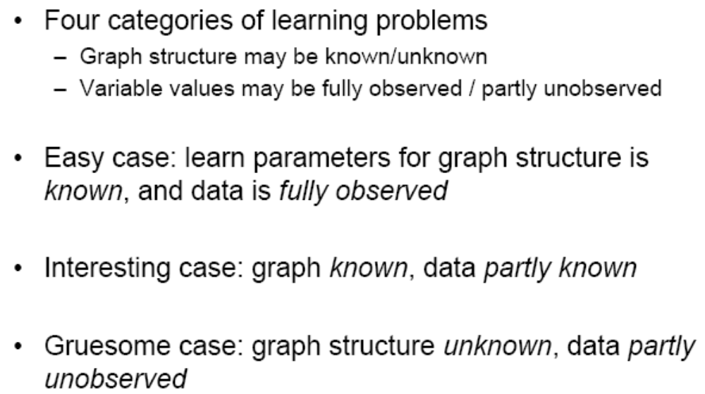
Learning of Bayes Nets

Slide 43
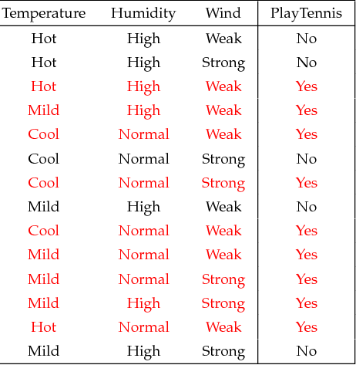
Learning CPTs from Fully Observed Data
T
H
W
PT
BayesNet = Graph + CPT
P(T), P(H|T), P(W), P(PT|HW)

Slide 44
Learning CPTs from Fully Observed Data
P(T), P(H|T), P(W), P(PT|HW)
P(T=hot)=4/14
P(T=mild)=6/14
P(T=cool)=4/14
P(H=high|T=hot)=3/4
P(H=high|T=mild)=4/6
….

Slide 45
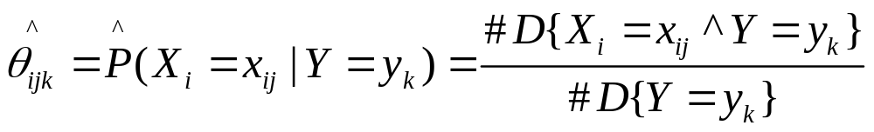
Learning CPTs from Fully Observed Data
MLE (Max Likelihood Estimate) is

Slide 46
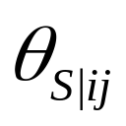
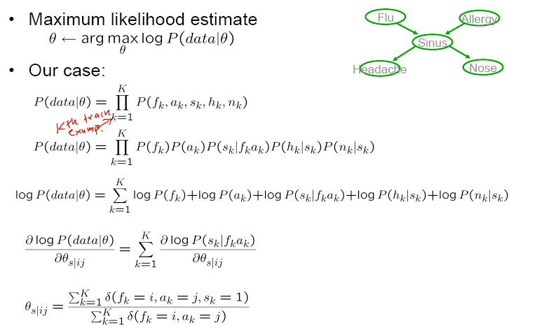
MLE estimate from fully observed data

Slide 47
Estimate θ from partly observed data
To Estimate P(T), P(H|T), P(W), P(PT|HW),
Now Can’t calculate through MLE!
T
H
W
PT

Slide 48
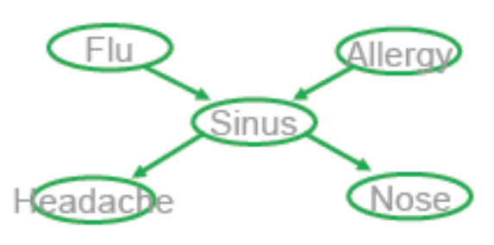
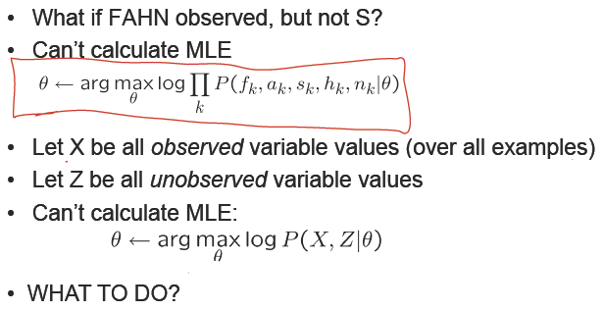
Estimate θ from partly observed data

Slide 49
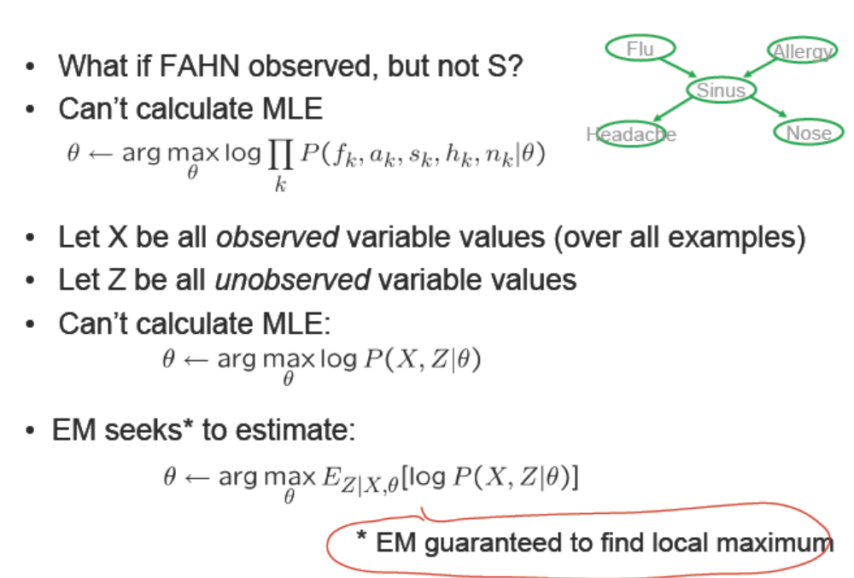
Estimate θ from partly observed data

Slide 50

EM

Slide 51

EM Algorithm

Slide 52



Slide 53


EM and Estimating

Slide 54

EM and estimating θ

Slide 55

Using Unlabeled Data to Help Train Naive Bayes Classifier

Slide 56


Slide 57

Text Classification from Labeled and Unlabeled
Documents using EM (cited times: 1737!)

